Slide 1
Post-Secondary Planning Information 2023-2024
© Burnett Counselling Department Oct. 27, 2023

Slide 2
Calming Down Strategy

Slide 3
Counsellors
Mr. Lim A-H Tuesdays & Wednesdays
Mr. Liu A-H Mondays, Thursdays & Fridays
Ms. Murad I-Se
Ms. Chen Sh-Z
Career Advisor
Ms. Carter Mondays, Thursday, every other Wednesdays

Slide 4
We Are Going to Cover…
Checking
Checking TVR’S (Transcript Verification Report)
Applying
Applying to University: EducationPlannerBC, OUAC (Ontario Universities Application Centre) or any other Canadian University
Subscribing
Subscribing to STS (Student Transcript Service)

Slide 5
STS
STUDENT TRANSCRIPT SERVICES

Slide 6
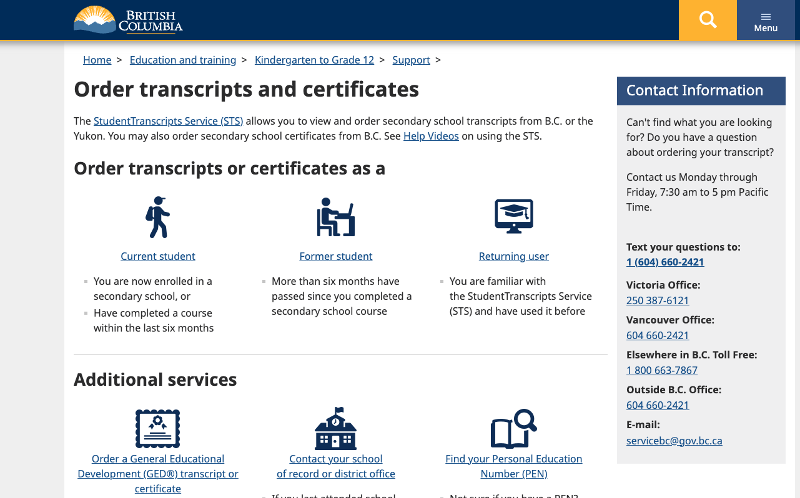

Slide 7
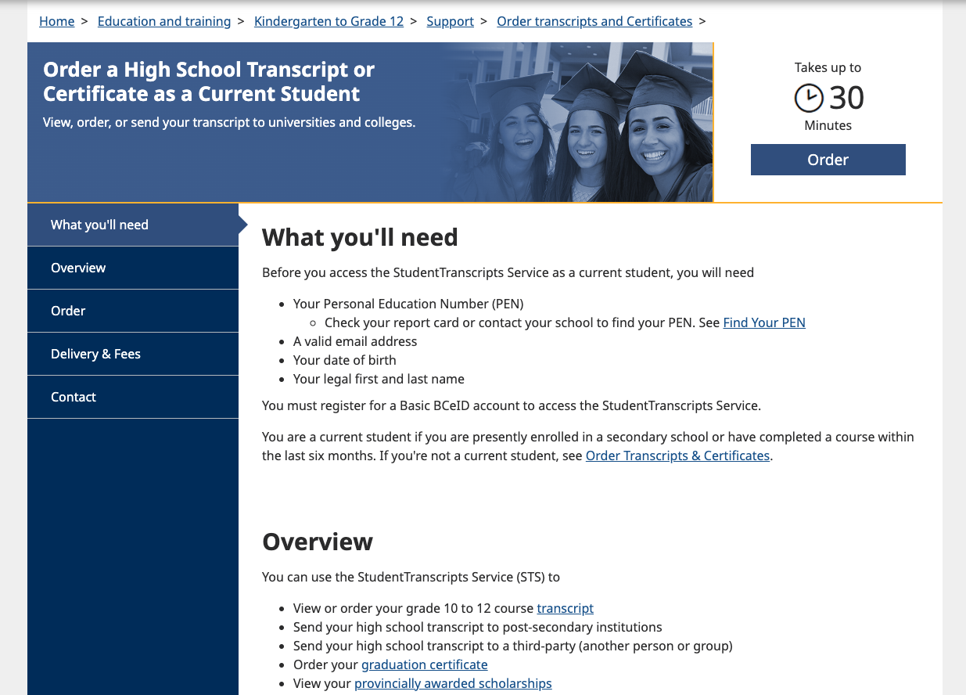

Slide 8
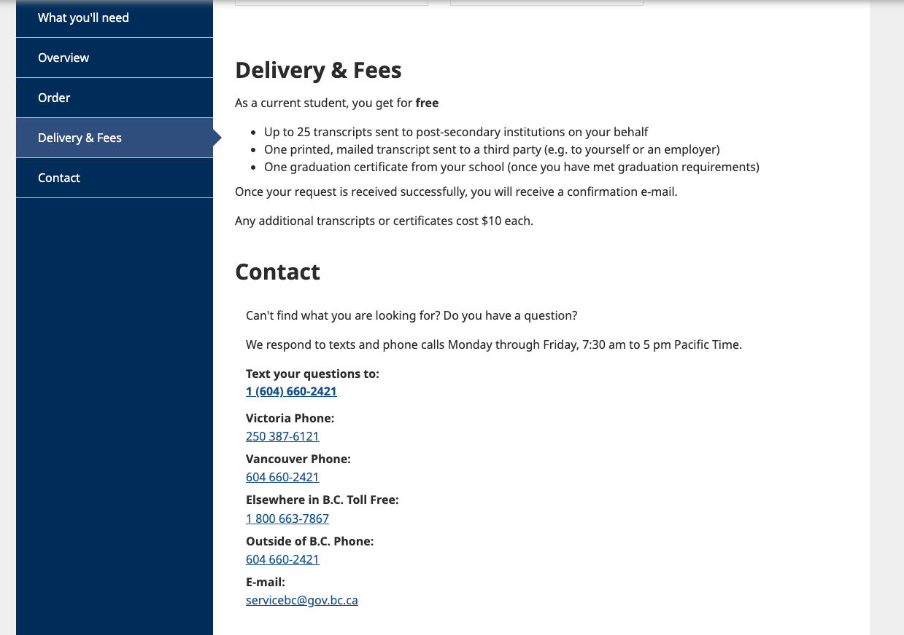

Slide 10
Step 1: Registering for Basic BCeID

Slide 11
Basic BCeID Authentication

Slide 12
Step 2: Registering for STS Student Register for the STS -Same Process

Slide 13
Student Receives an Email- Same Process

Slide 14
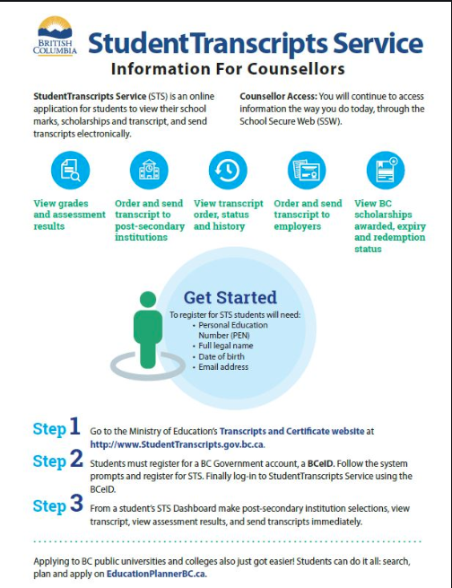
How to Order and or Send a Transcript to a Post –Secondary Institution

Slide 15
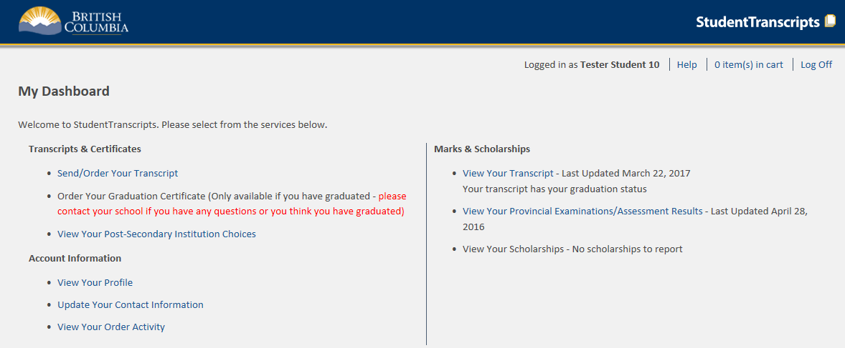
Student Transcripts Service Dashboard

Slide 16
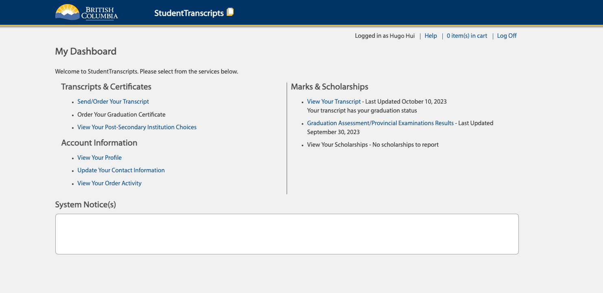

Slide 18
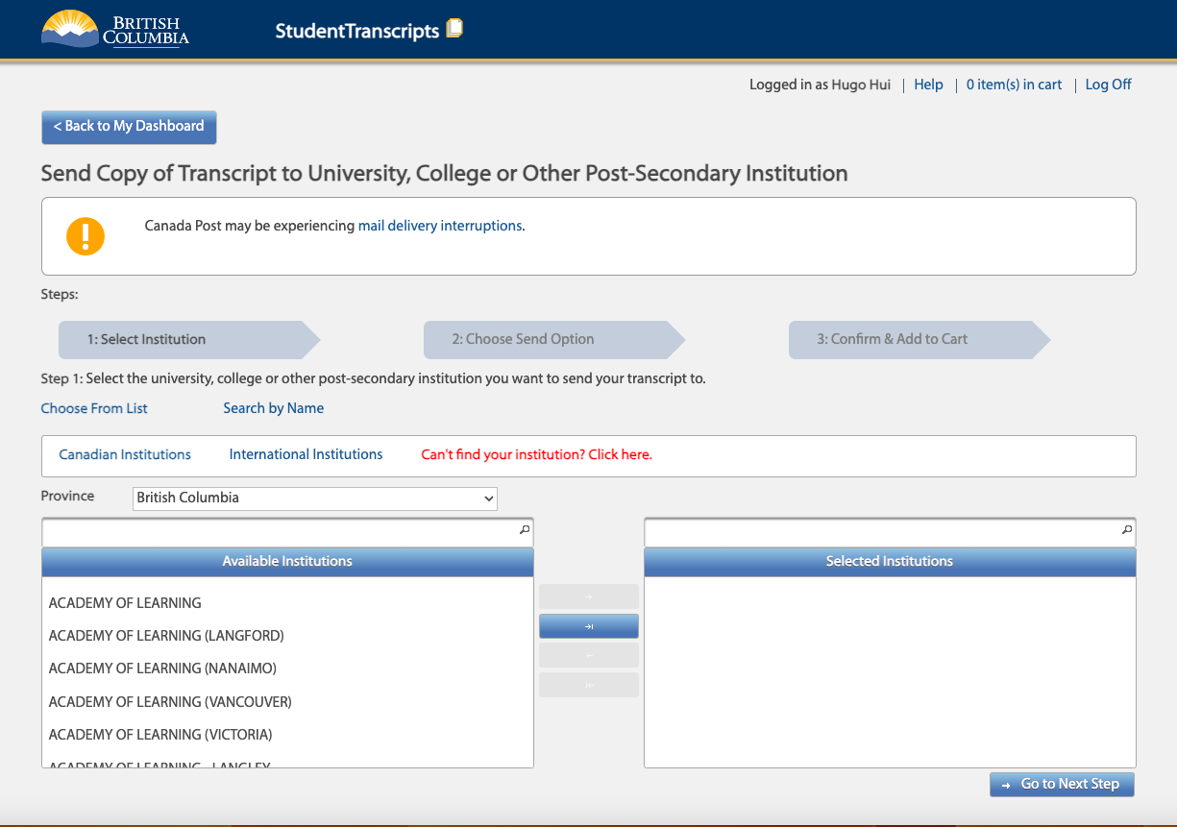

Slide 19
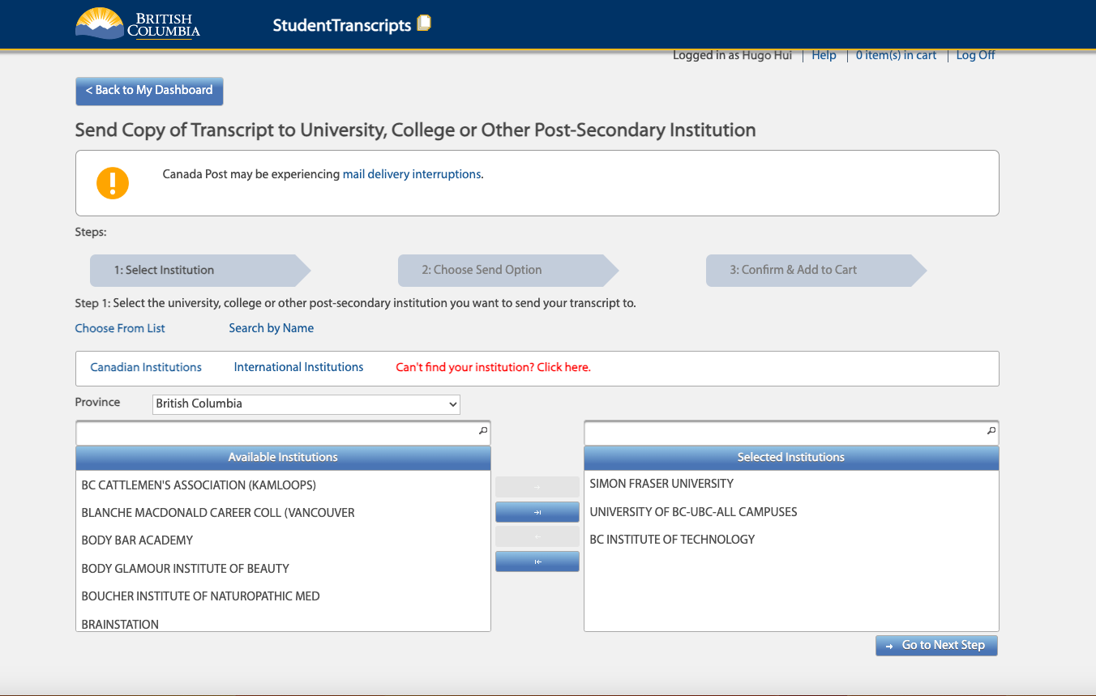

Slide 20
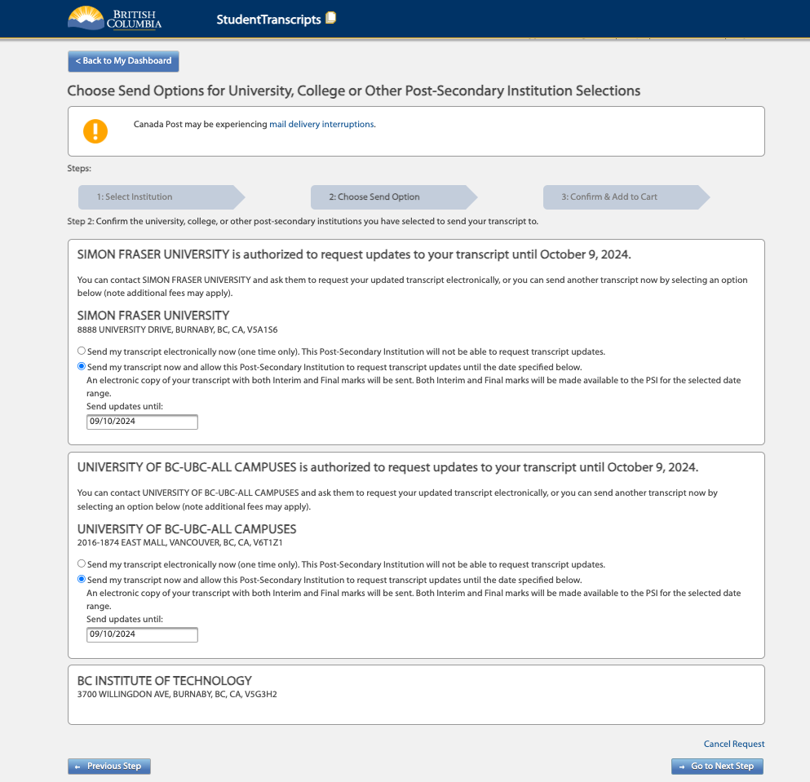

Slide 21
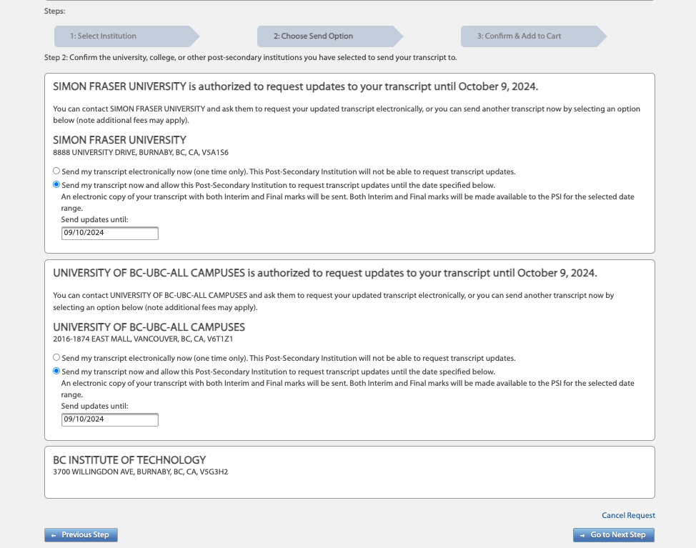

Slide 22
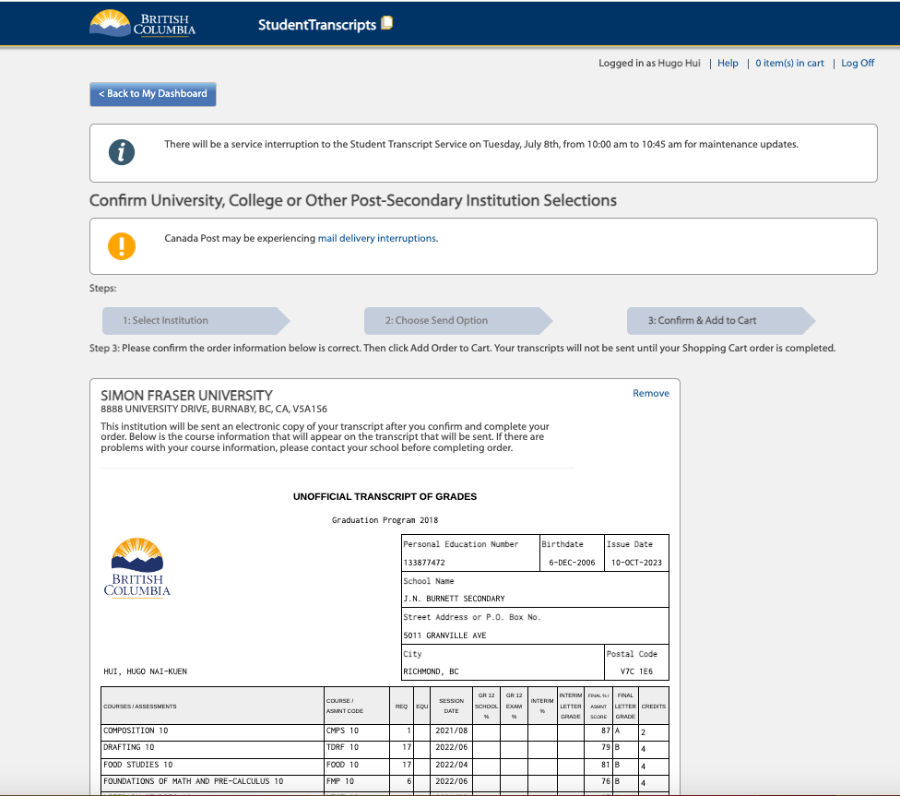

Slide 23
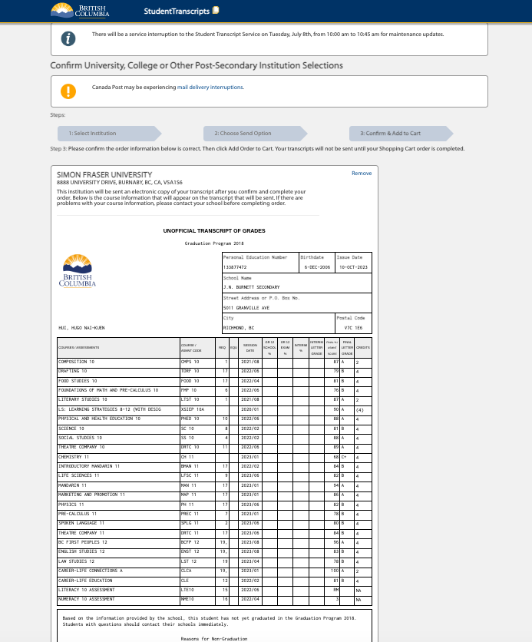

Slide 24
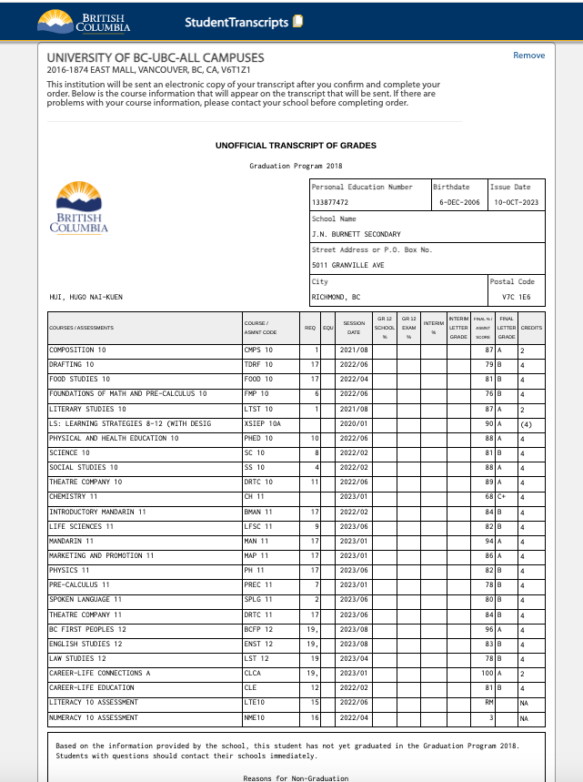

Slide 25
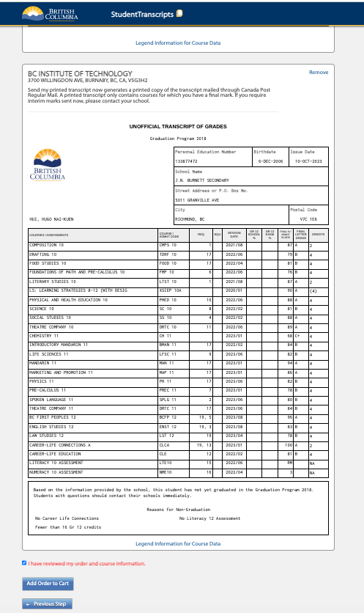

Slide 26
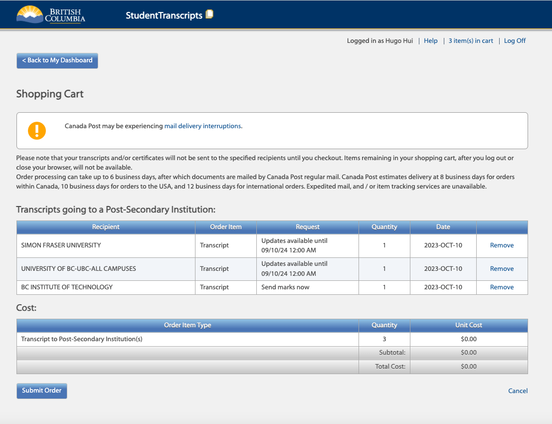

Slide 27
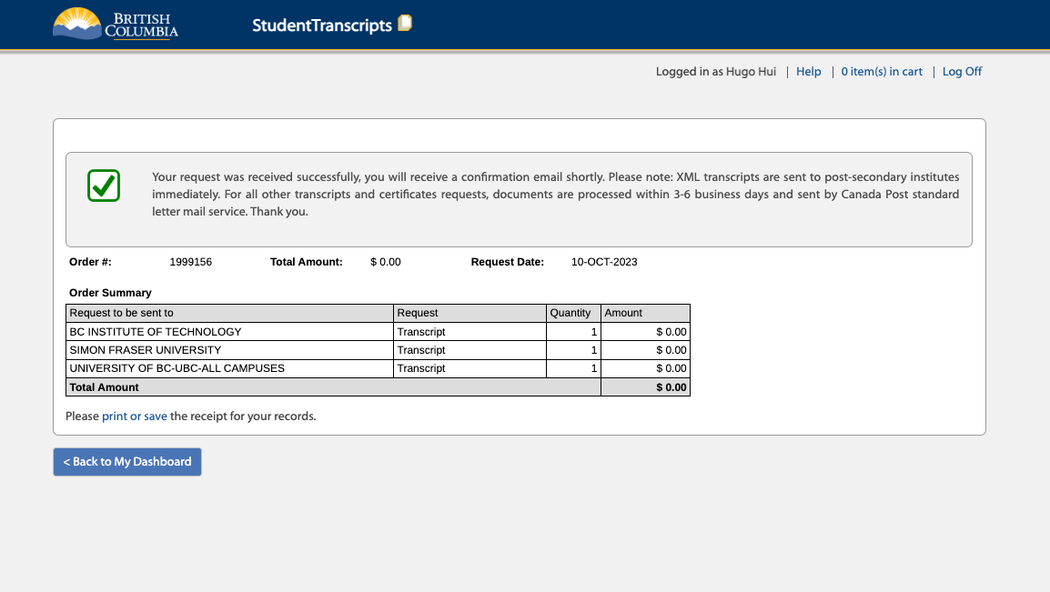

Slide 28
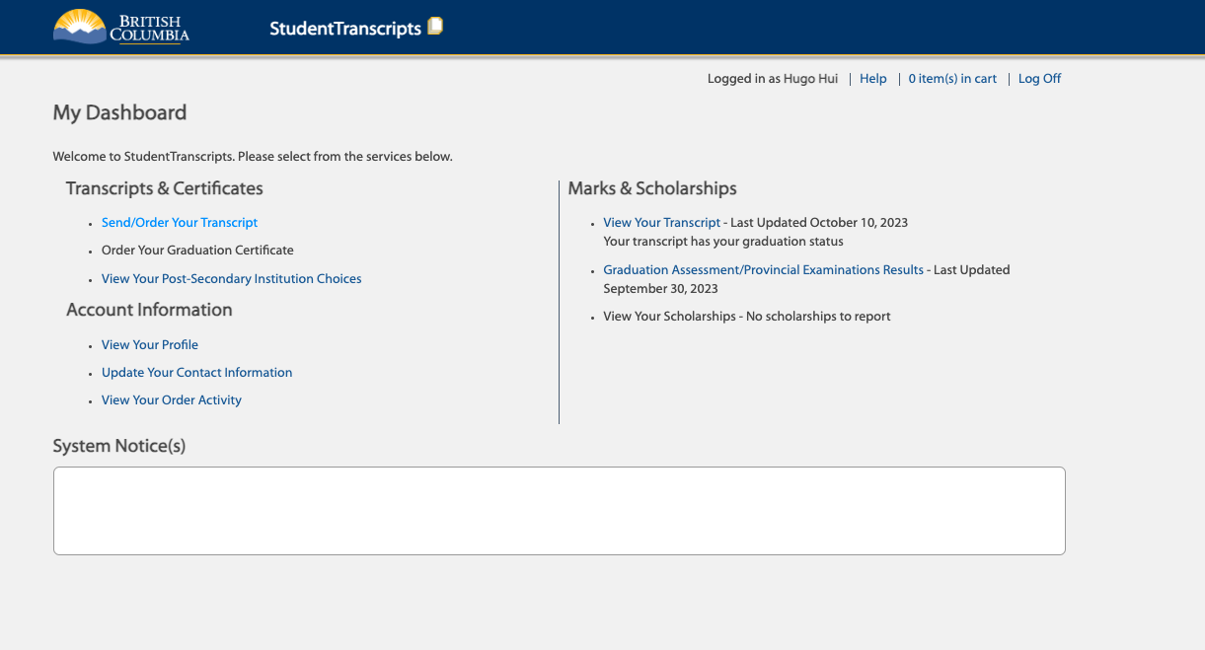

Slide 29
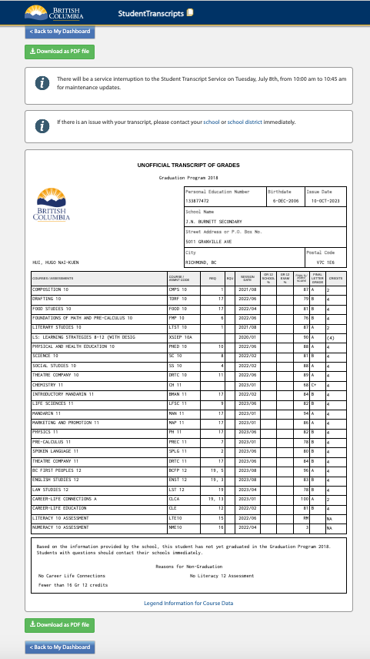

Slide 30
Applying to PSI’S

Slide 31
Important Sites
EducationPlannerBC EducationplannerBC
OUAC – Ontario Universities Centre OUAC
CommonApp – Universities in the States CommonApp

Slide 32
Apply
Apply Online
Need
Need to know what program you want
Need
Need credit card for application fee
Need
Need Personal Education Number (PEN)
Need
Need to send transcripts through Student Transcript Service (STS) using BCeID
Notes:
Stress, can always change mind, can choose something general,
Think of it as a buffet

Slide 33
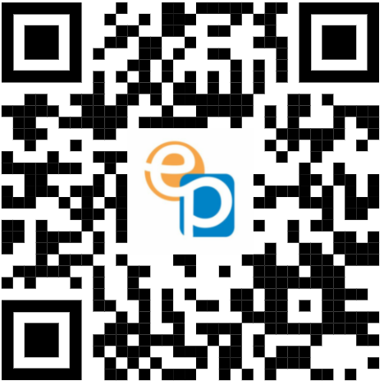
Educational Planner BC's Website
Educational planner BC QR

Slide 34
Create an Account

Slide 35
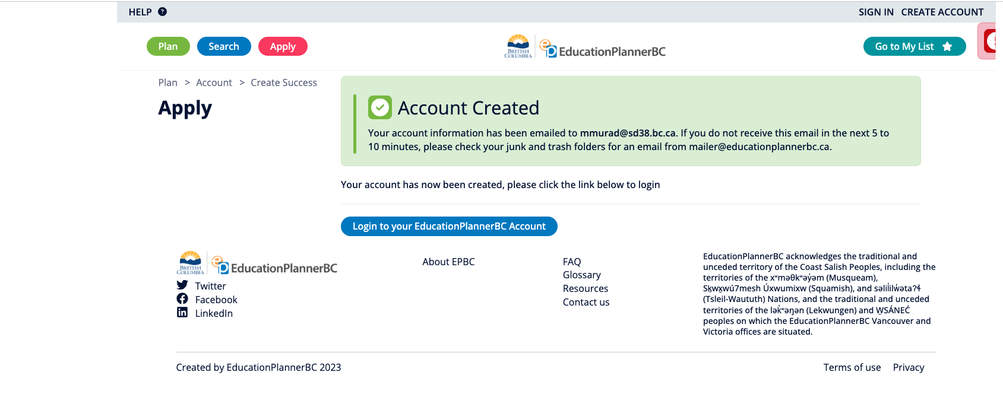

Slide 36
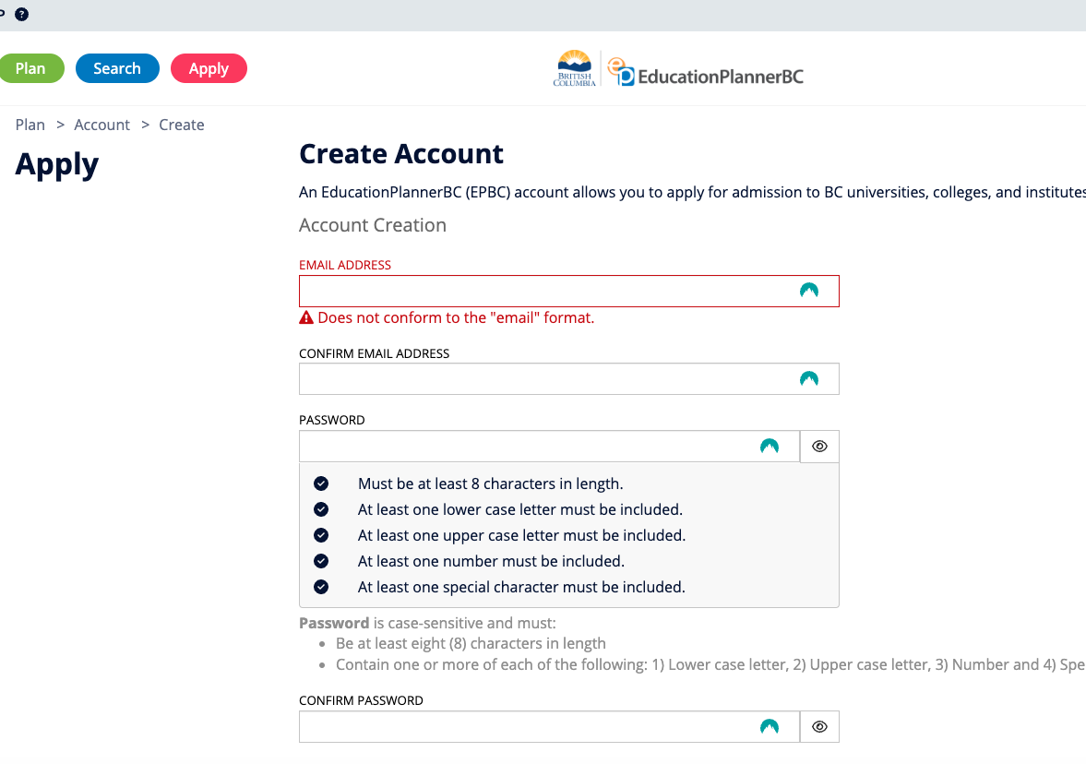

Slide 37
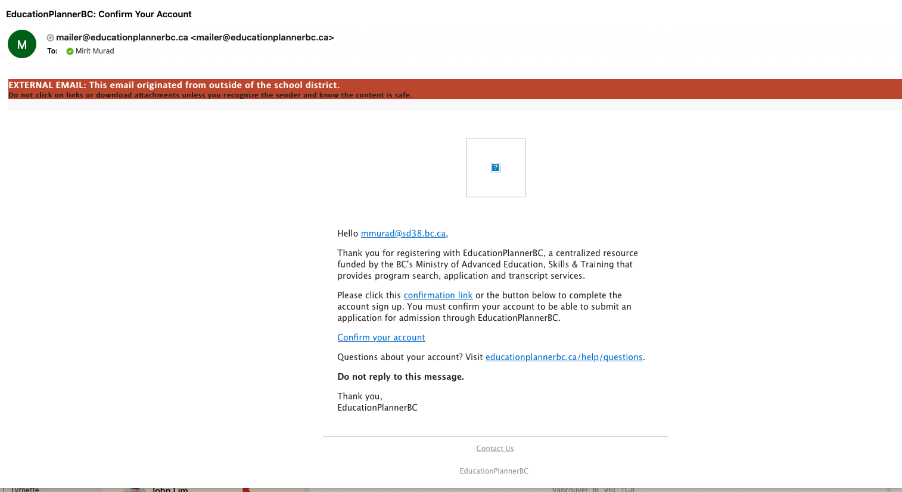

Slide 38
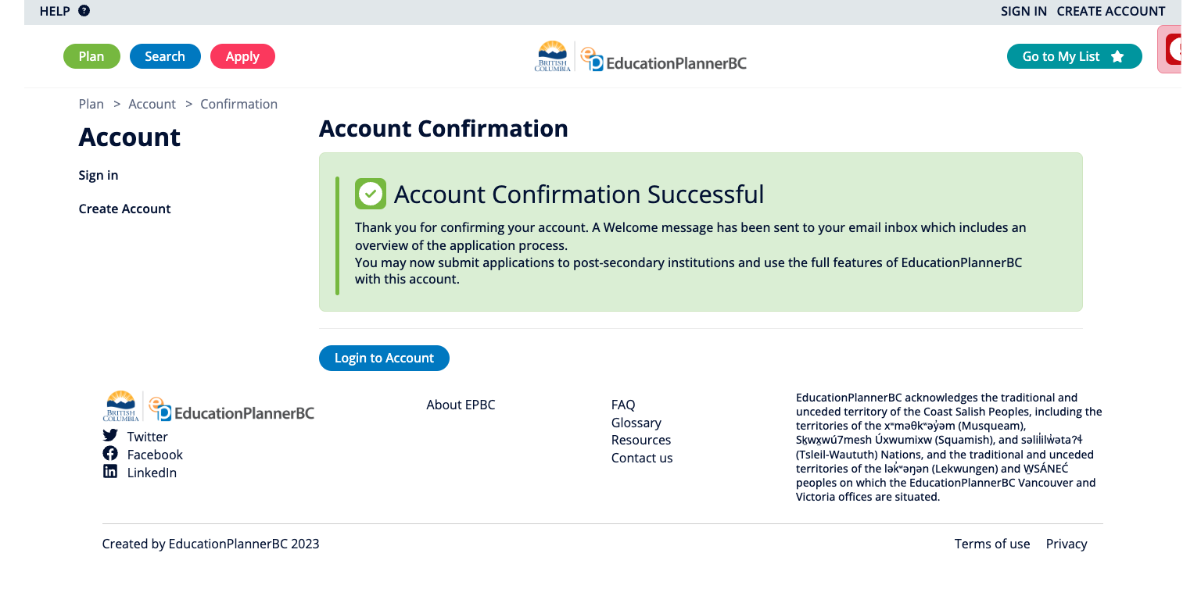

Slide 39
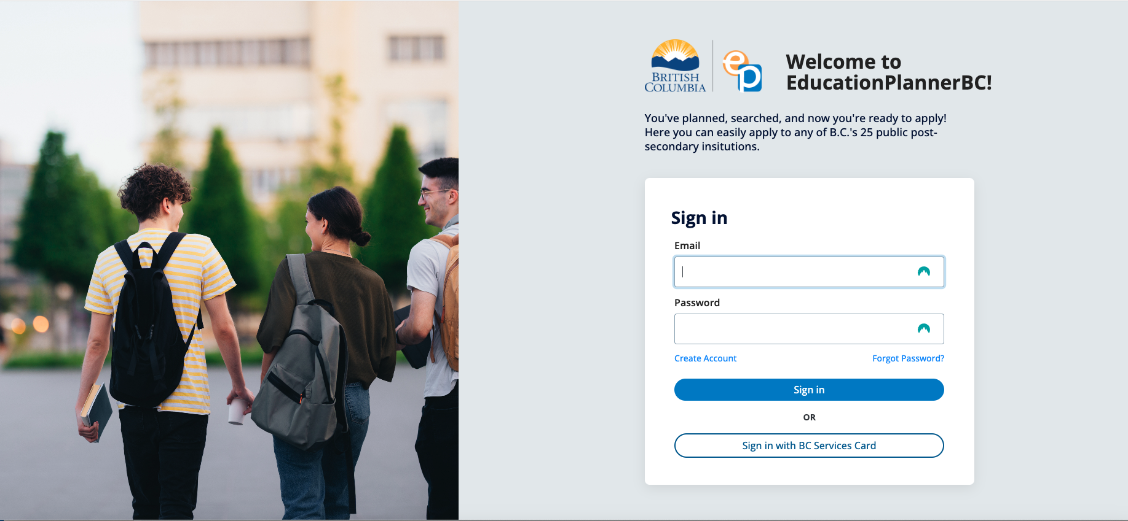
Sign In

Slide 40
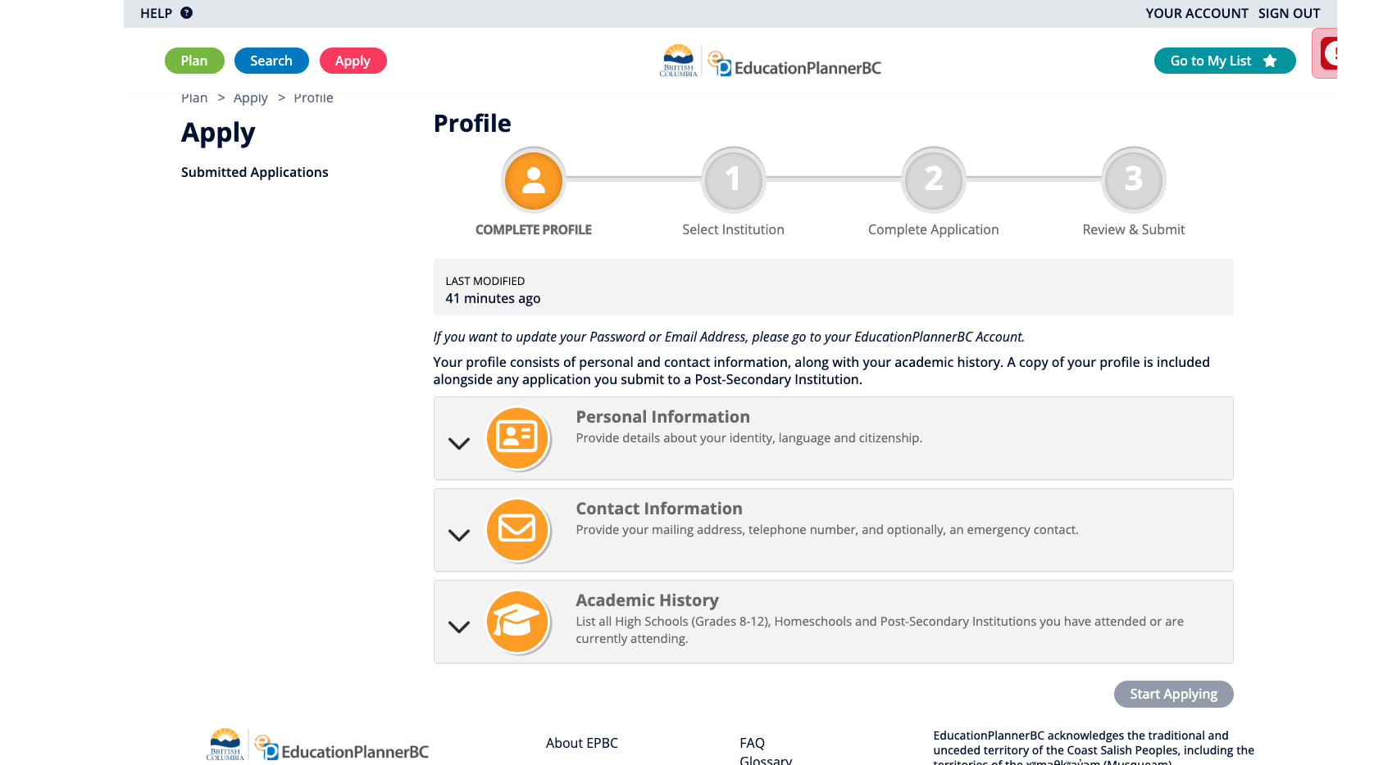
Apply

Slide 41
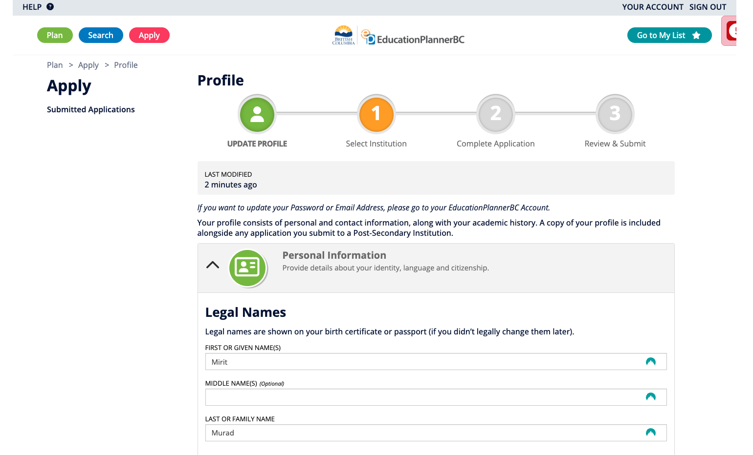

Slide 42
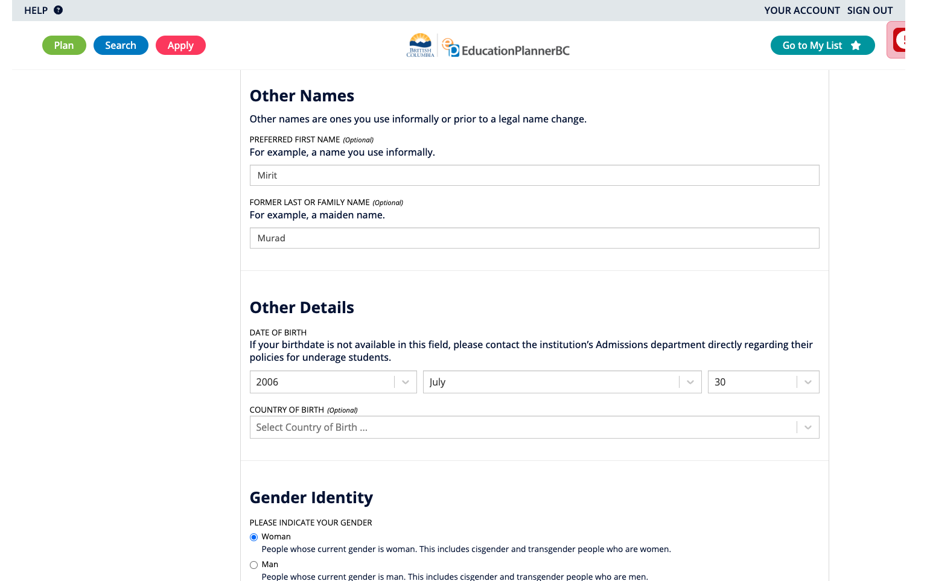

Slide 43
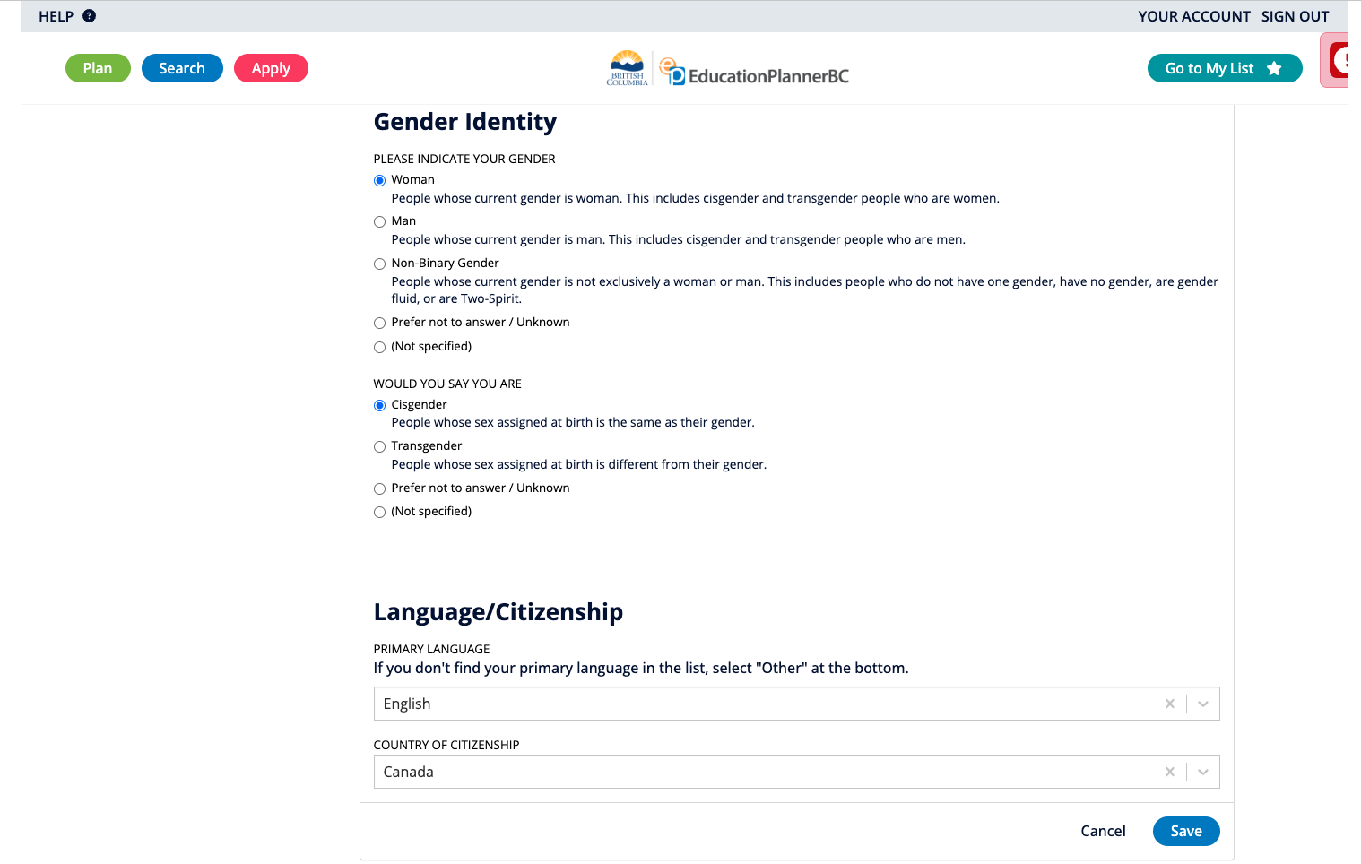

Slide 44
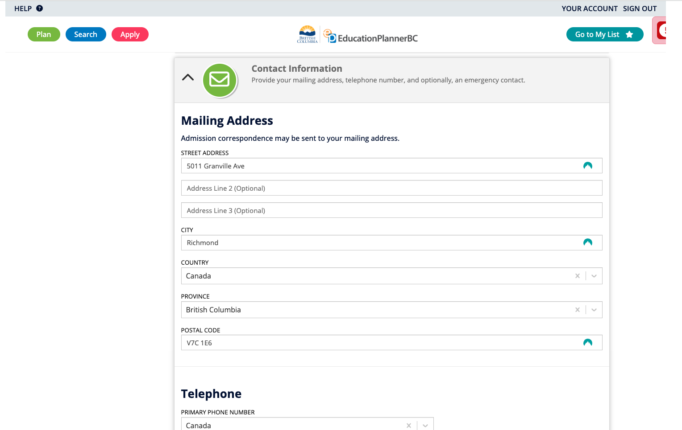

Slide 45
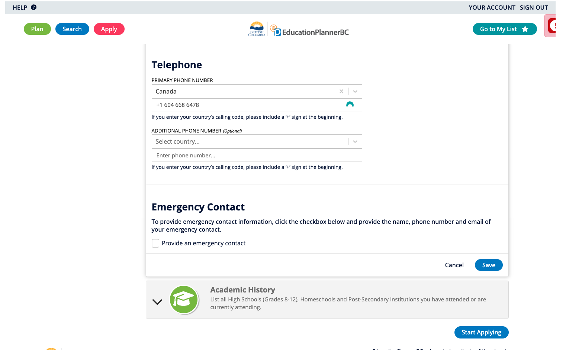

Slide 46
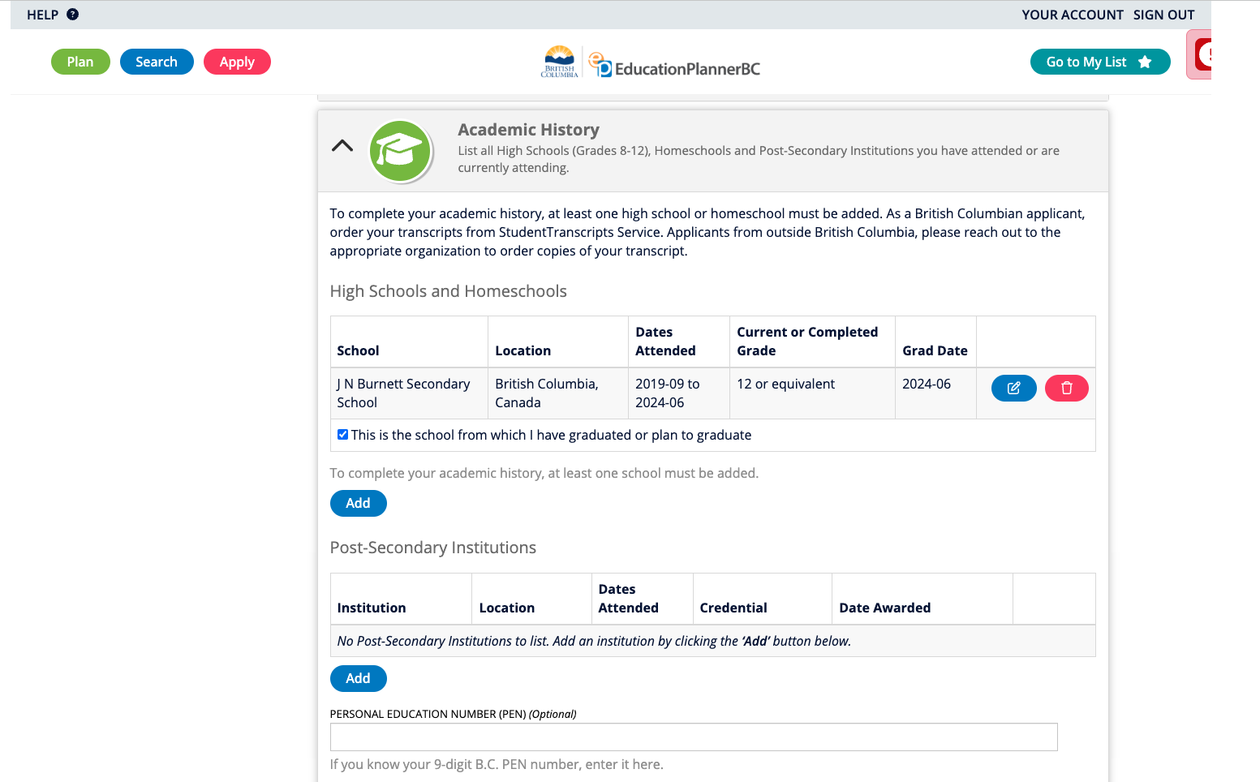

Slide 47
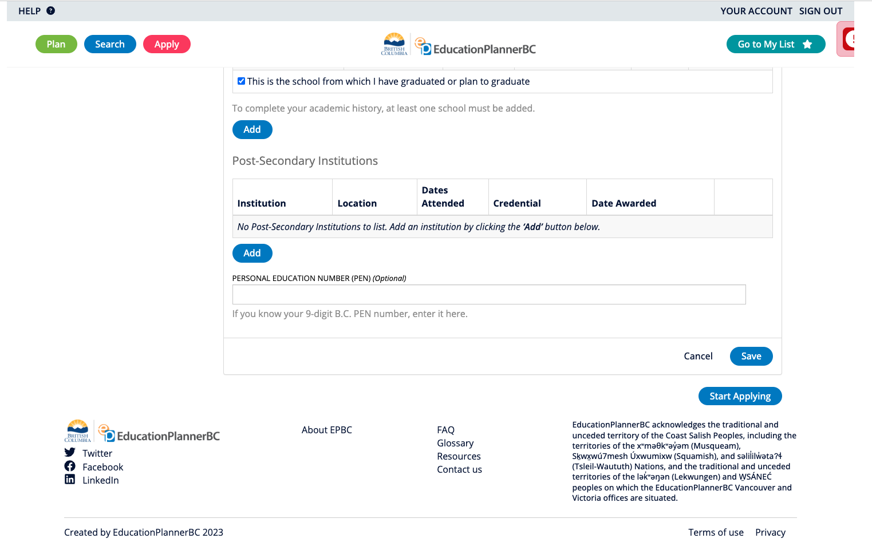

Slide 48
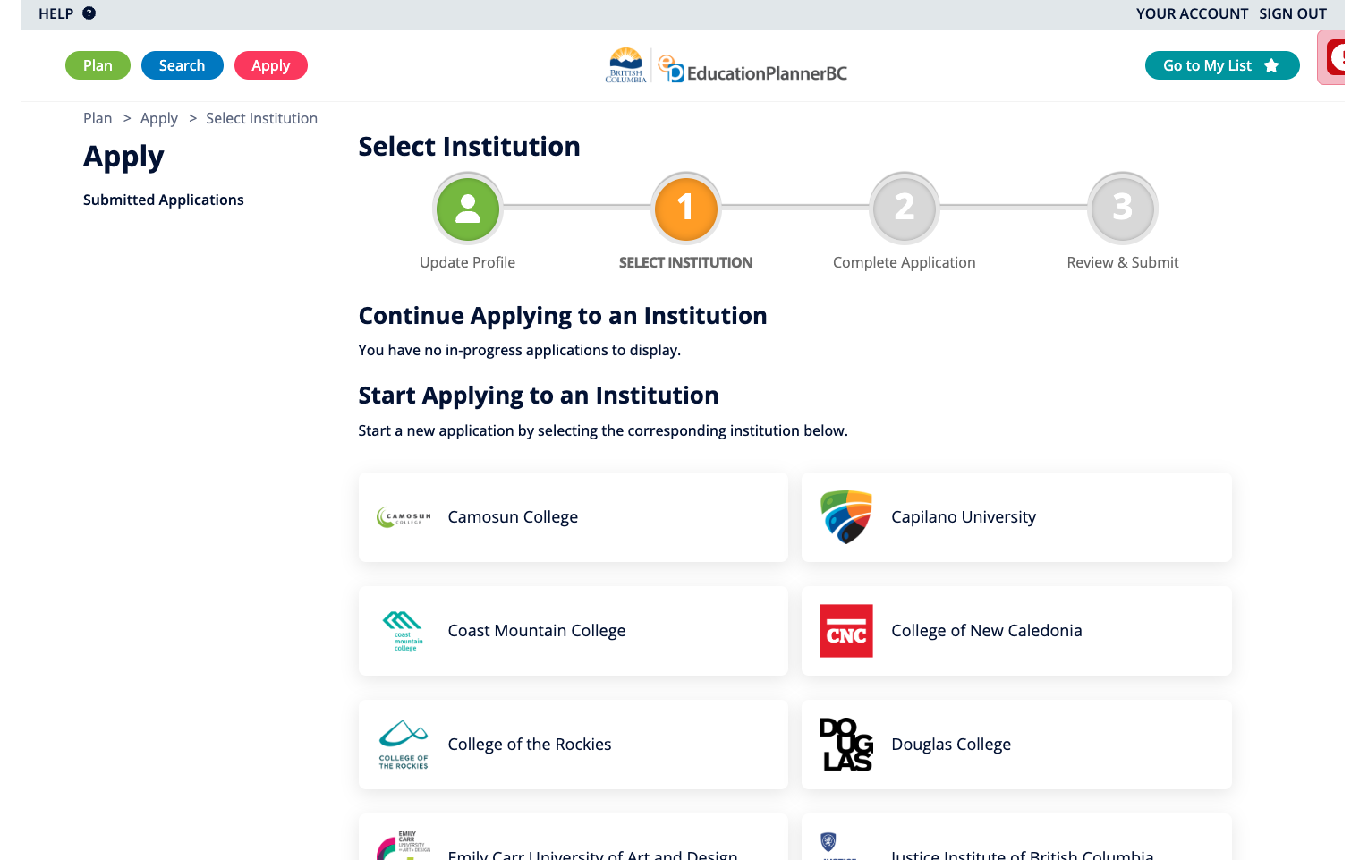

Slide 49
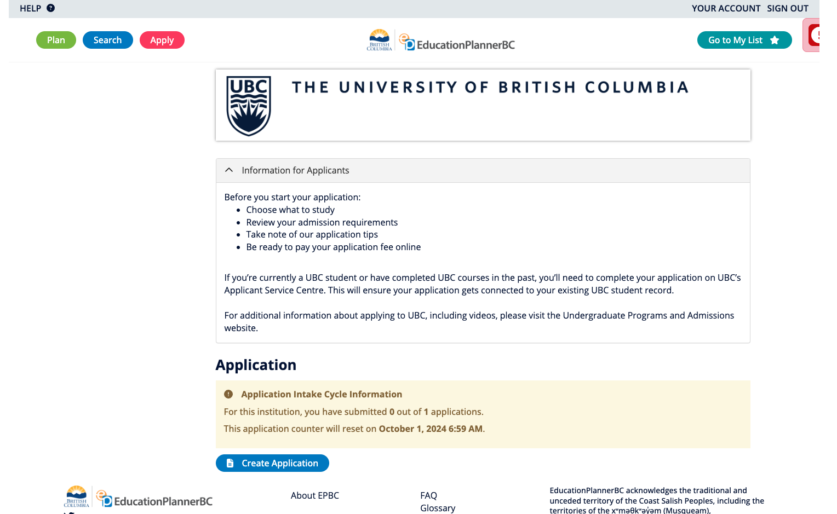

Slide 50
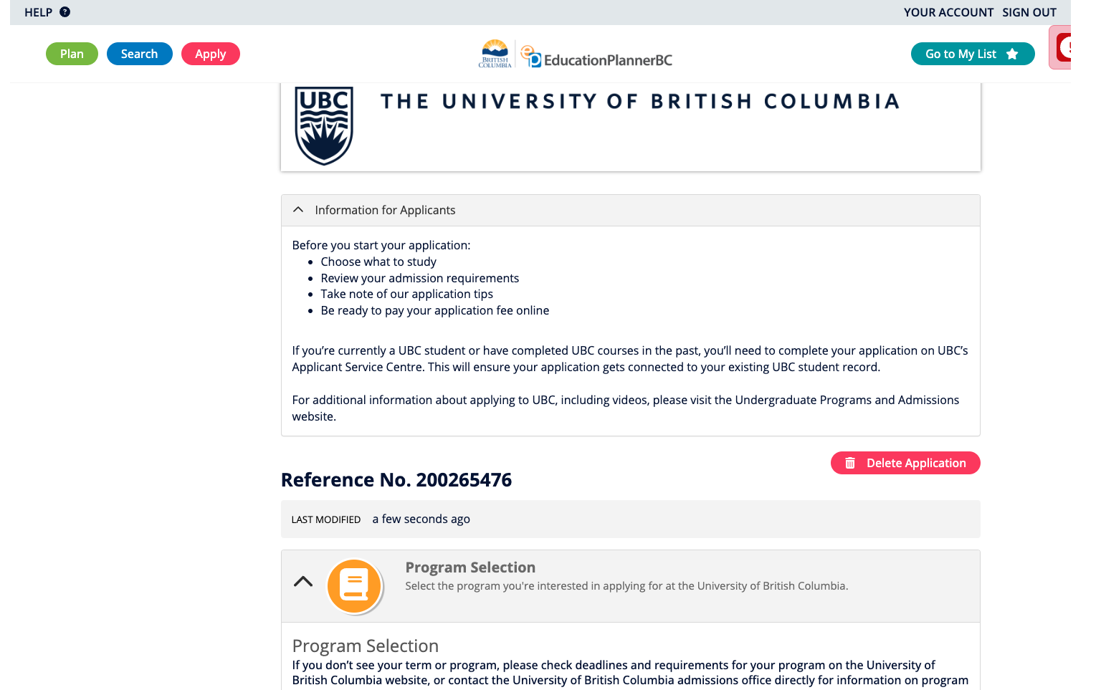

Slide 51
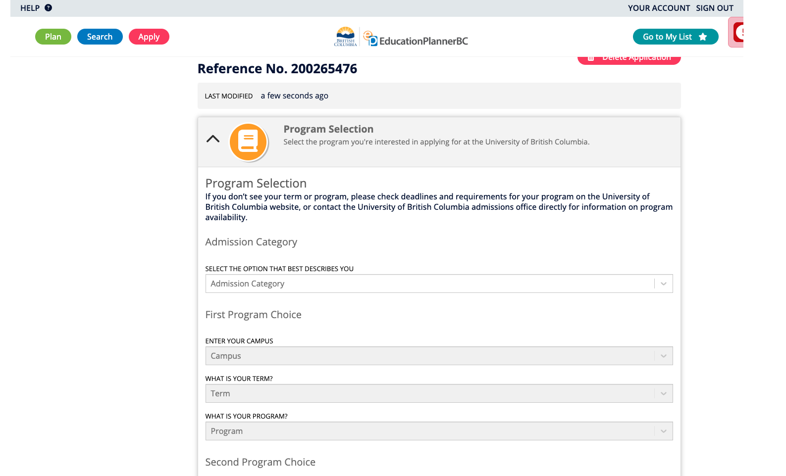

Slide 52
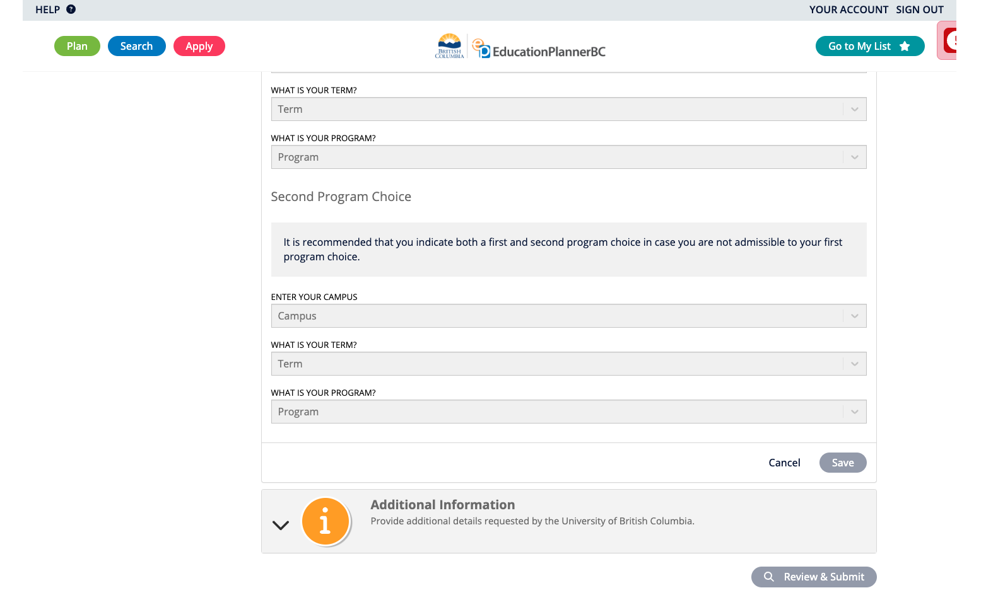

Slide 53
Official Transcript Requests
You may be asked for an official transcript
Fill out white form in the office and bring $5
Must be hard copy & verified as “official” (Burnett Seal)
Do not open the sealed envelop (the information may be deemed invalid if envelop is opened)
Give at least 24 hours notice for request

Slide 54
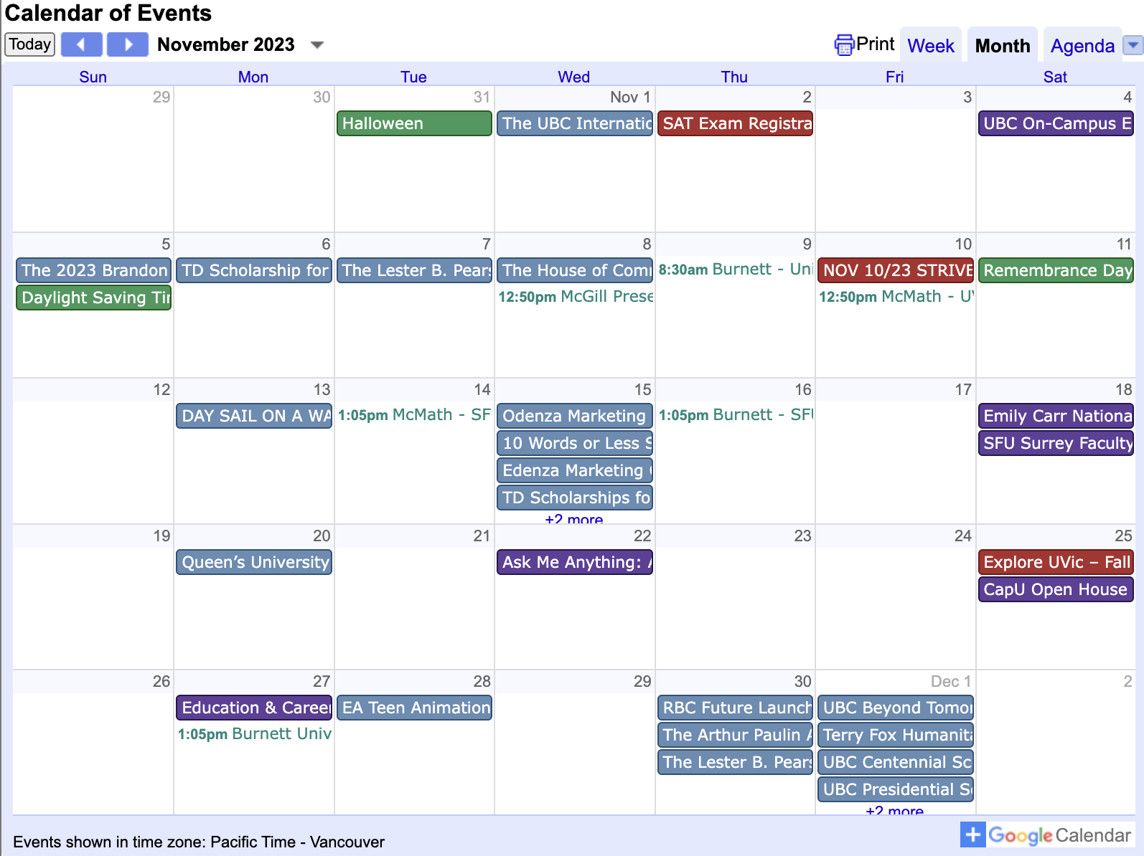
Careers & Post Secondary Information
Ms. Carter
Burnett Career Centre Information for
Career Centre - Post Secondary Info
Grad Info
Apprenticeship Info
Scholarships/Financial
Careers
How to find this information
Burnett Website > Student Life > Career Centre

Slide 55
J.N. Burnett Career Centre
Check your email regarding notice of upcoming events and scholarships
01
Check out notices around the school and listen to the daily announcements
02
Make appointments to see Ms. Carter
03
Email:
shcarter@sd38.bc.ca
04

Slide 56
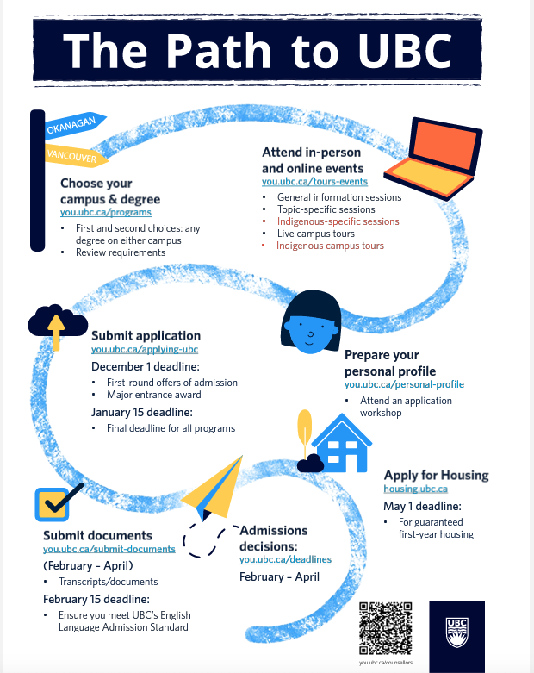
UBC Important Information
Graduation Literary Assessment GLA 12
Proficient (3) is required for UBC

Slide 57
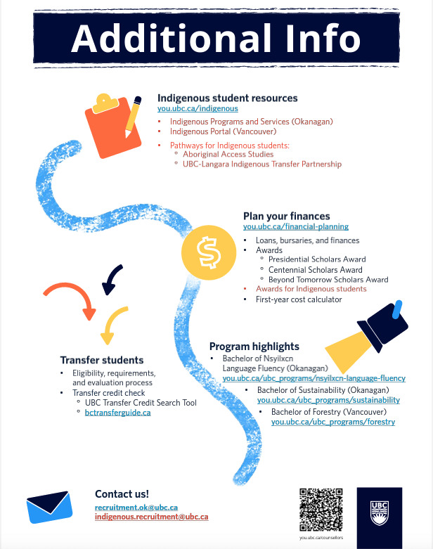

Slide 58
UBC

Slide 59
Self-reporting of grades
Many applications require that students “self-report” grades
Enter grades for completed courses
Predict grades of courses in progress (good idea: ask your teachers for the most current marks)
The windows for self reporting are very important for admission and scholarship offers
Notes:
Be sure to check your emails!
Create an “appropriate” email address

Slide 60
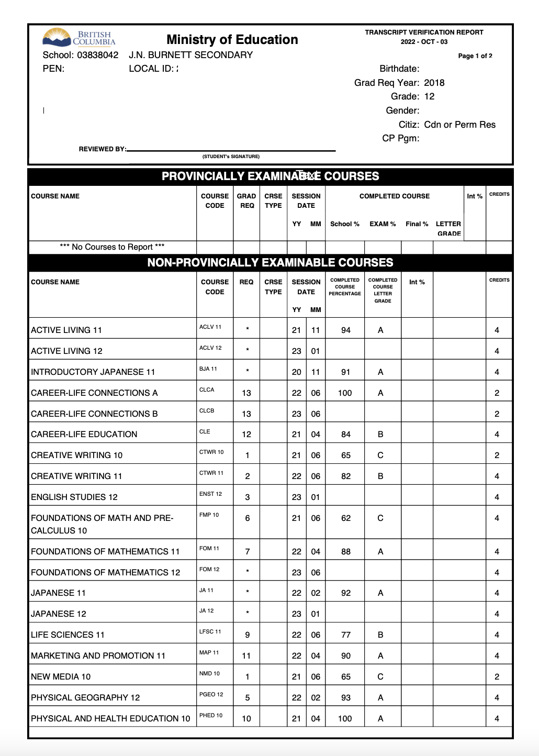
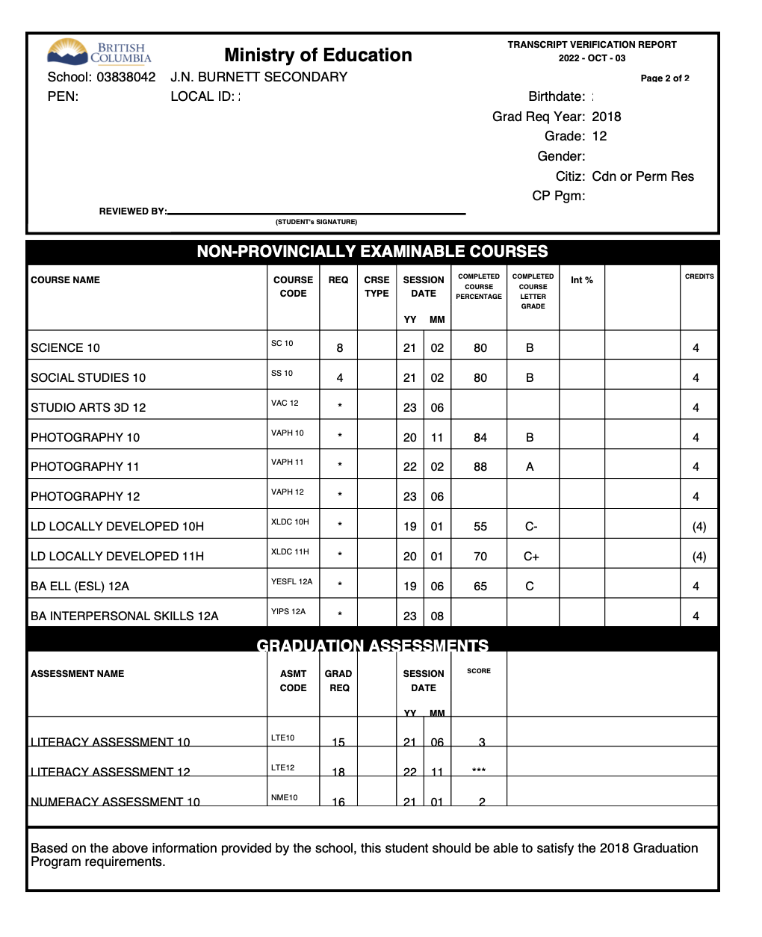
TVR’S

Slide 61
Checking TVR’S
Check that your personal information is correct and updated
Check your (current and completed) courses and correct grades
Some courses may have a slightly different name
Only when all the info is correct, sign your name on top of both pages
If some of the info is not correct, put a note on the top of the first page and contact your counsellor

Slide 62
TVR Page 1

Slide 63
TVR Page 2

Slide 64
TVR’S DEADLINE End of Session
Bring your TVR in person to your counsellor
Make sure you checked it and signed both pages
If something is incorrect circle it or highlight it and do not sign the TVR
Take a picture of the TVR on your phone for your own copy

Slide 65
RESOURCES

Slide 66
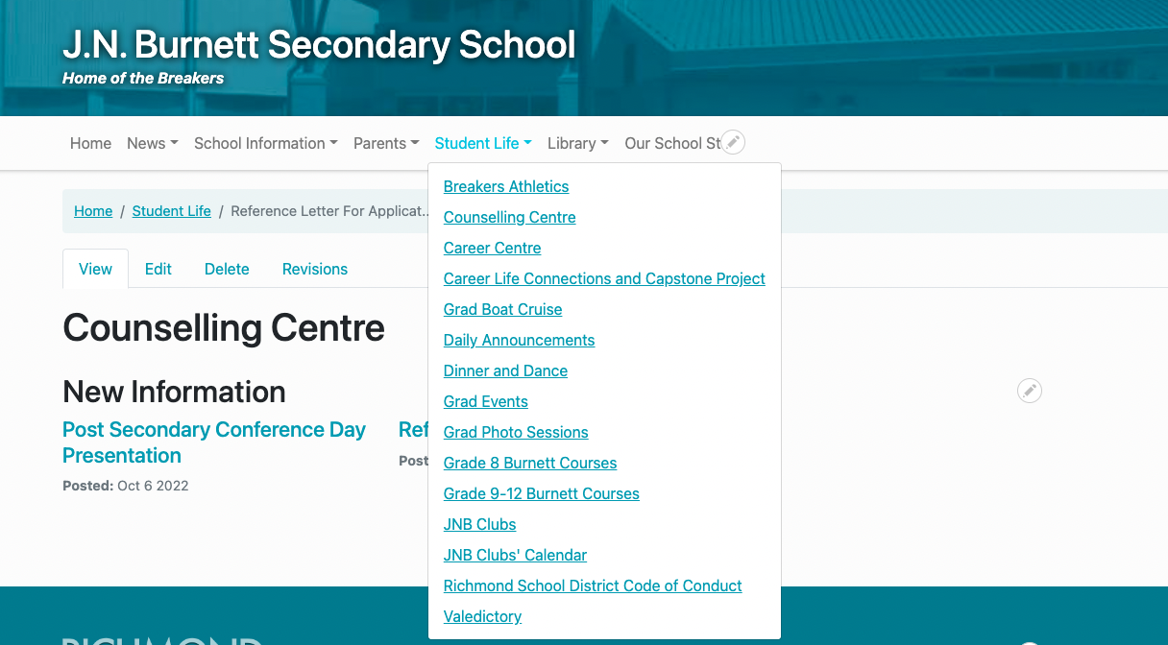
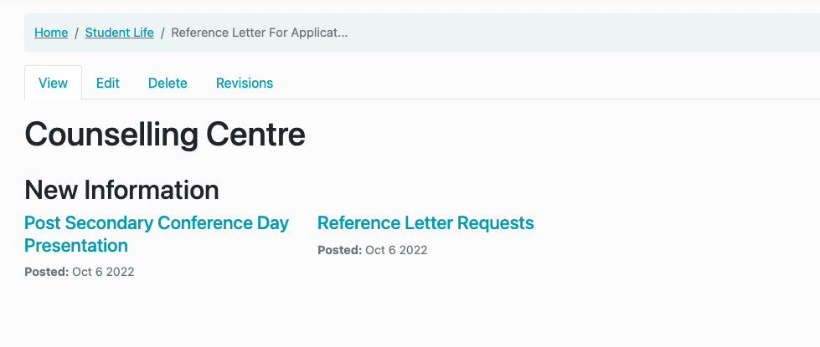
Post-Secondary Planning Information 2023-2024

Slide 67
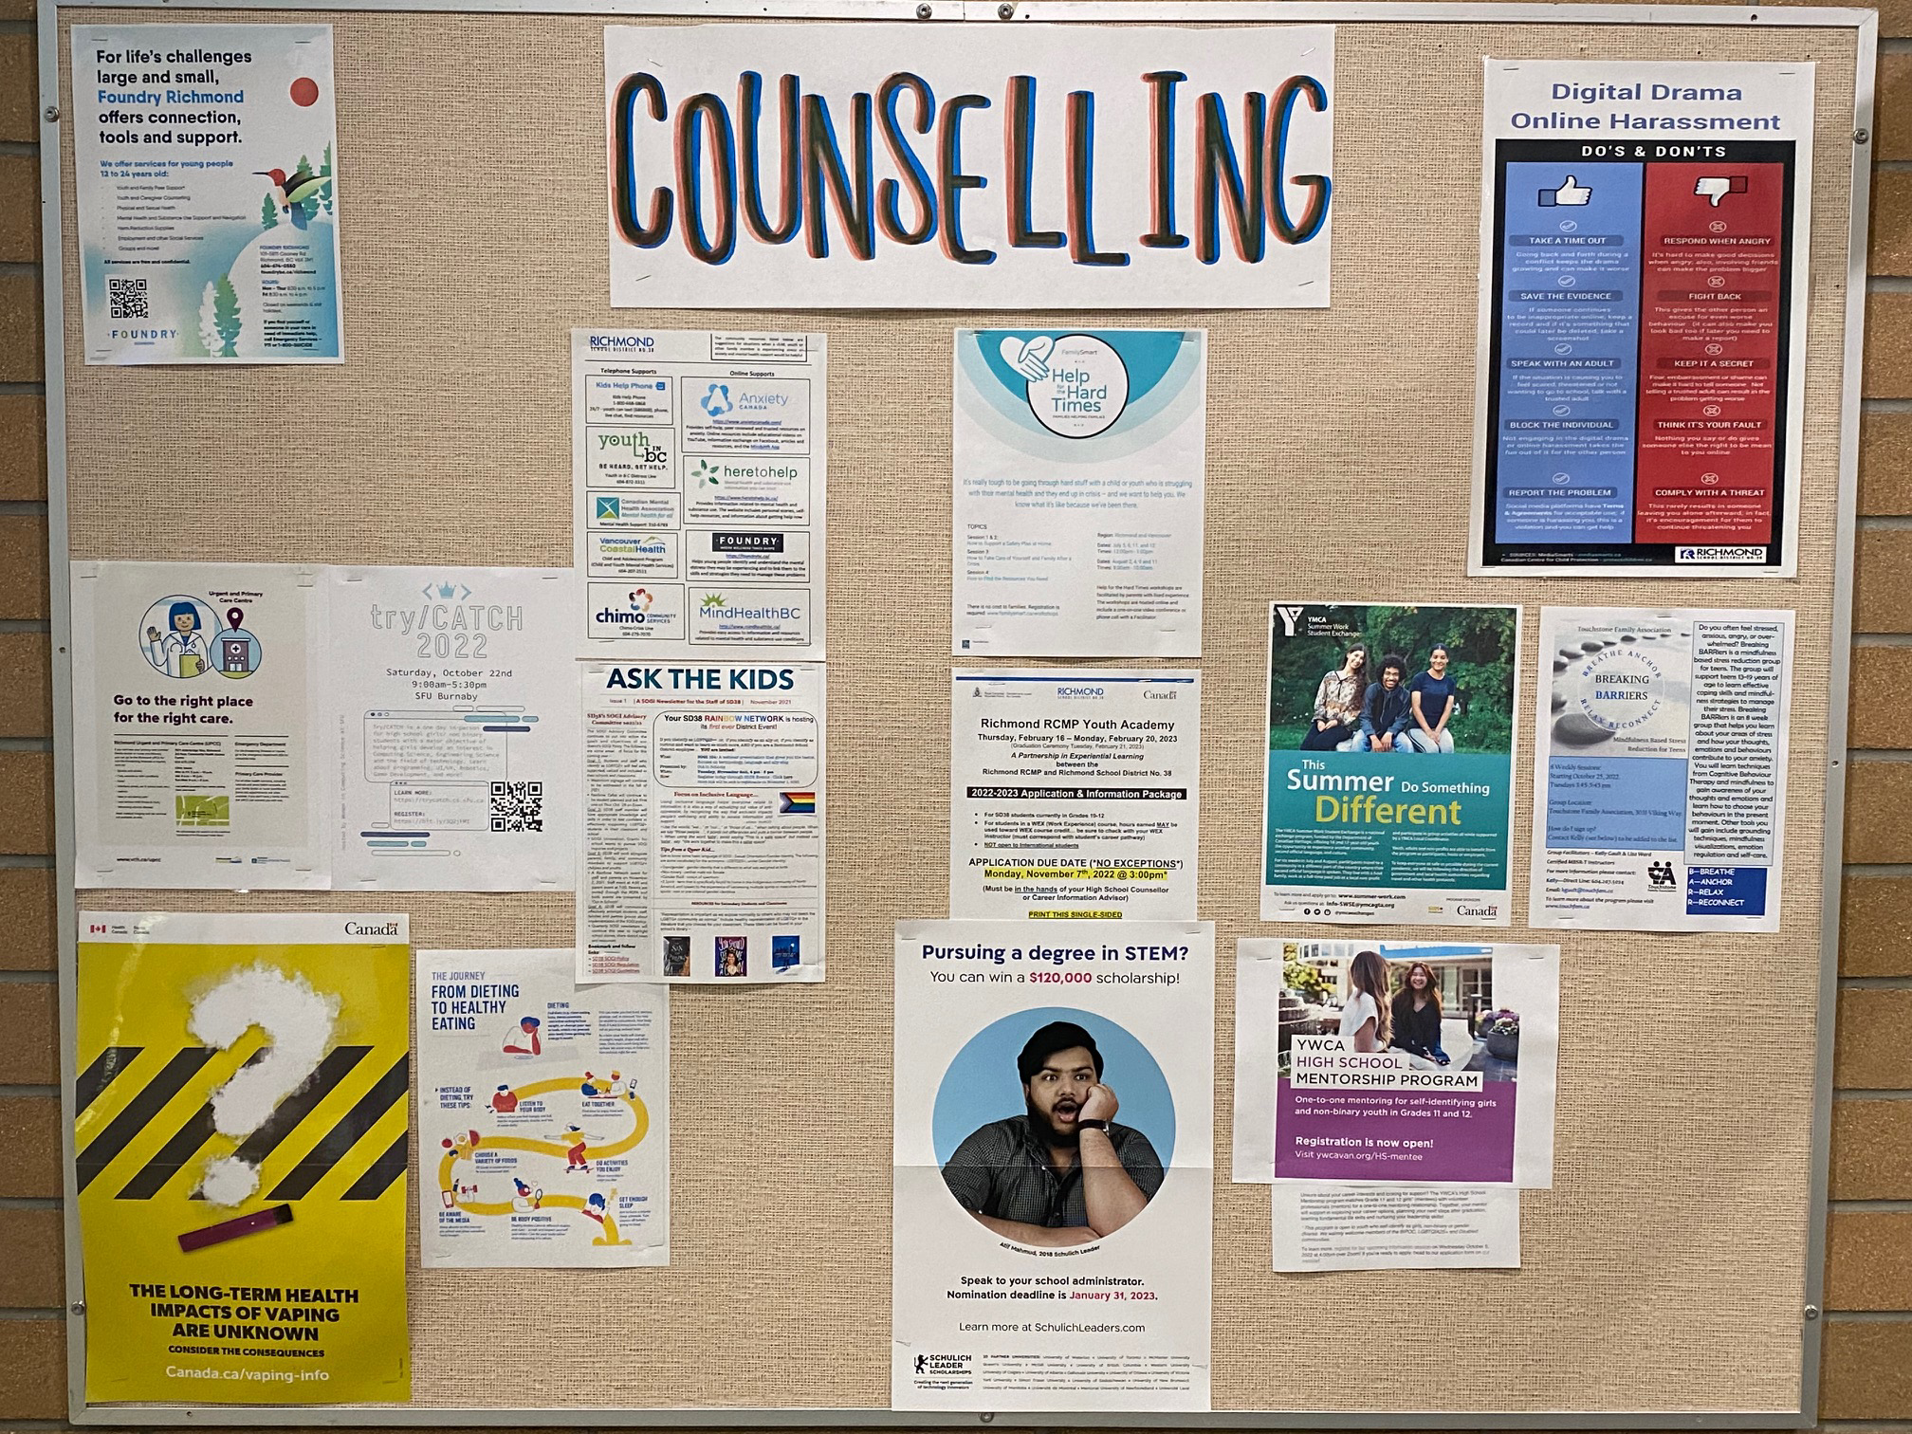
Important Information
Daily Announcements
TV Screens at School

Slide 68
Good Luck!
The Counsellors

